Slide 1


DESIGN AND SIMULATION OF AN
IP-BASED REAL-TIME PATIENT MONITORING SYSTEM

Slide 2
INTRODUCTION
Real-time patient monitoring is essential in modern healthcare.
Quick response to abnormal patient vitals can save lives.
Project simulates an IP-based patient monitoring system using Cisco Packet Tracer.
Connects virtual health sensors in hospital rooms to a central monitoring system.

Slide 3
OBJECTIVE
Simulate a hospital network with patient health devices.
Use IP communication for real-time data transfer.
Trigger alerts on abnormal health conditions.
Demonstrate IoT device integration in a smart hospital setup.

Slide 4
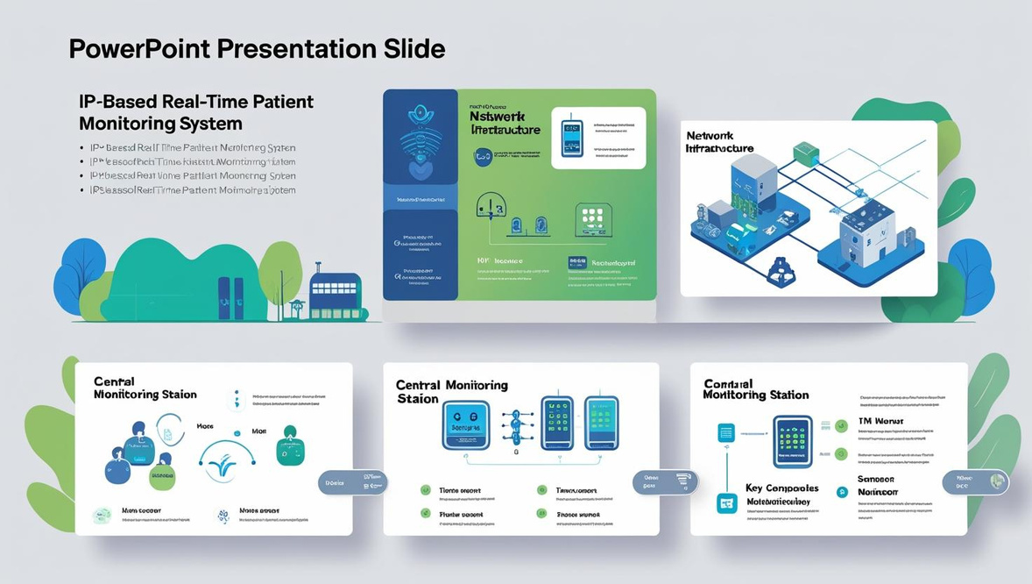
TOOLS USED
Cisco Packet Tracer
IoT Smart Devices:
Smart Temperature Sensor
Heart Rate Monitor
Logic Blocks
Networking Components:
Switches, Routers, PCs
Server as Central Monitoring Unit
Protocols Used:
DHCP / Static IP
HTTP for alerts

Slide 5
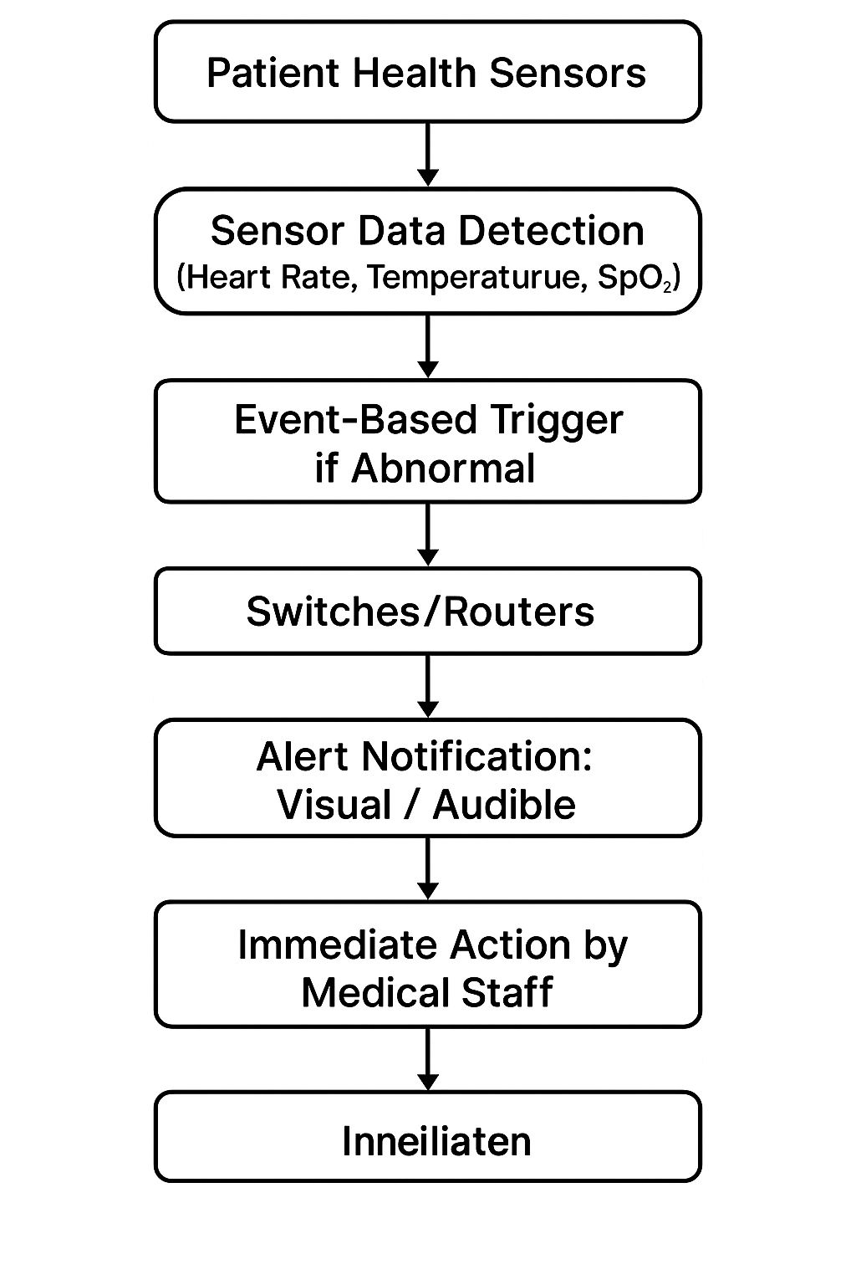
NETWORK DESIGN OVERVIEW

Slide 6

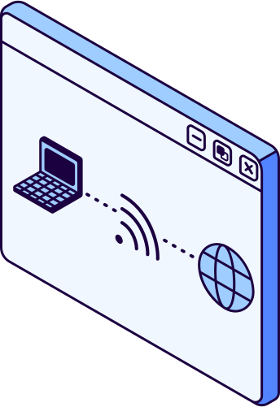
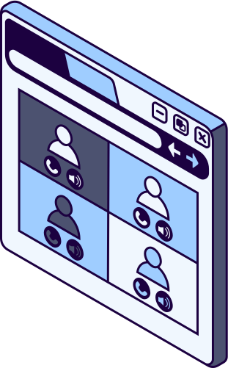
COMMUNICATION FLOW
Sensor detects a value (e.g., high temperature).
Sends data to the server/nurse’s PC using IP communication.
Event-based logic triggers alert (visual/audible notification).
Ensures immediate action.

Slide 7
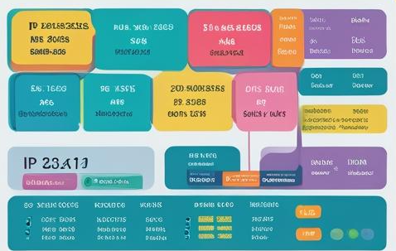
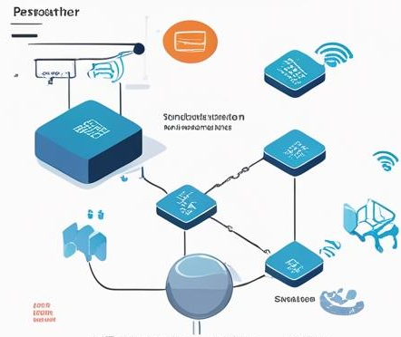
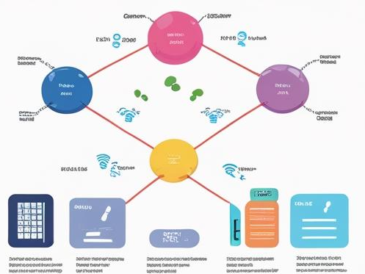
KEY NETWORKING CONCEPTS
IP Addressing
Device-to-device Communication
IoT Integration

Slide 8

PROJECT WEBSITE OVERVIEW & FEATURES
Home Page
Network Topology
Documentation
Project introduction
Technologies used in the project
Live network topology - Floor plan.
Device level interaction
Objectives, Architecture
Implementation and Testing
Files Page
Team Page
Assignment and project submissions
Download options
Team members, institution
Mission statement

Slide 9
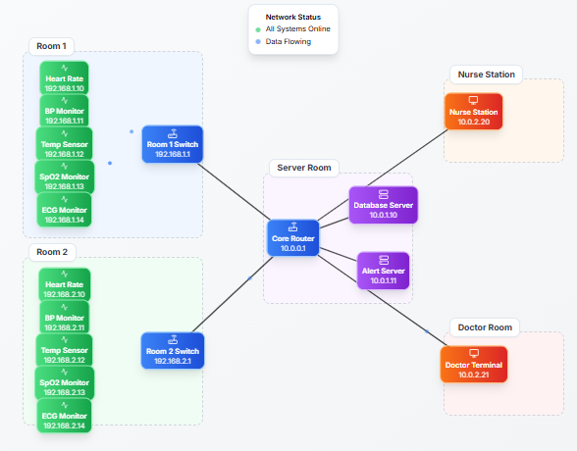
PROJECT WEBSITE - NETWORK TOPOLOGY
Floor Plan - Live Network Topology
System Flow
Sensor Data (Heart Rate, Temp, SpO2) → Router/Switch →
Core Router → Alert & Database Servers → Nurse/Doctor Stations
Key Innovations
IP-Based Simulation: Assigns IPs to virtual devices for real communication
IoT Logic Blocks: Automates alerts using event-based logic
Smart Alerts: Emergency notifications for abnormal health readings
Hospital-Wide Connectivity: Secure data flow between departments
Modular Design: Easily extensible for future rooms/sensors

Slide 10
ADVANTAGES
Real-Time & Centralized Monitoring:
Enables instant detection of abnormal vitals and reduces manual efforts by centralizing patient data analysis at a nurse station or server.
Scalable & Modular Network Design:
Easily expandable to new rooms or departments, with flexible architecture allowing independent upgrades of sensors, switches, or servers.
Automated & Cost-Efficient Simulation:
Event-based alert triggers in Cisco Packet Tracer provide realistic automation without expensive hardware, making it ideal for academic and prototype development.
Educational & Future-Ready Platform:
Bridges networking theory and practical IoT applications in healthcare, while supporting integration with real-world protocols and future enhancements like mobile apps or cloud dashboards

Slide 11
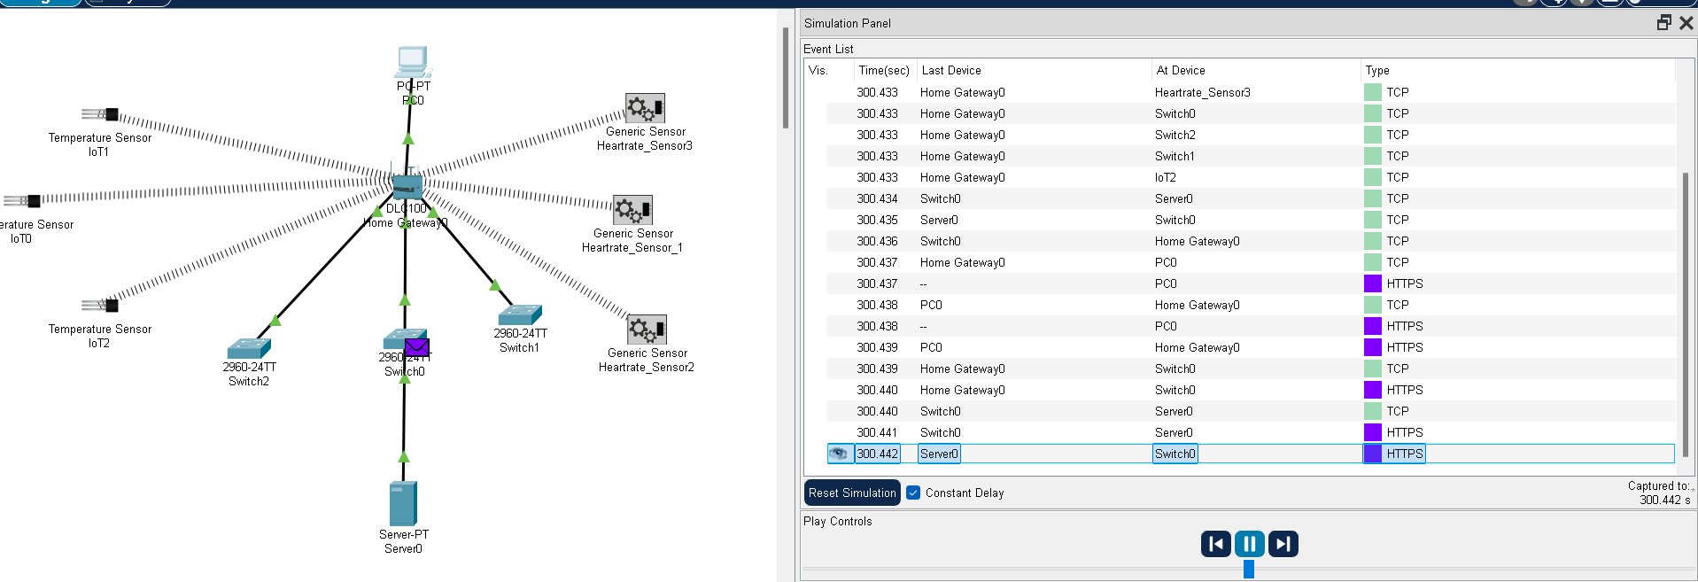
RESULTS

Slide 12
CONCLUSION
This project demonstrates how IP-based communication and IoT integration can simulate a smart hospital setup.
Using Cisco Packet Tracer, we built a functional model for real-time patient monitoring with event-triggered alerts.
It bridges the gap between theoretical networking concepts and real-world healthcare applications.
With further enhancements, such as real sensors, cloud connectivity, and mobile apps, this model can evolve into a real-world prototype for smart patient care systems.
Ultimately, this project highlights how technology can transform healthcare — making it faster, safer, and more connected.

